Slide 1
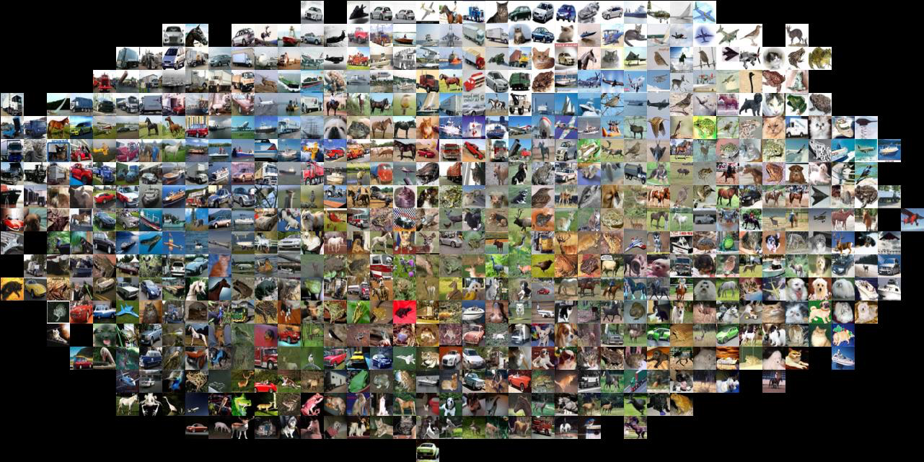
Lecture 13: Recognition Basics
CS5589: Computer Vision
Bei Xiao
Slides from Andrej Karpathy and Fei-Fei Li
http://vision.stanford.edu/teaching/cs231n/

Slide 2
Today
Project 5 review
Image classification pipeline
Training, validation, testing
Nearest neighbor classification
Score function and loss function
Intro to deep learning

Slide 3


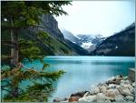

Image categorization
Training
Training Images
Training Labels
Image Features
Classifier Training
Trained Classifier

Slide 4
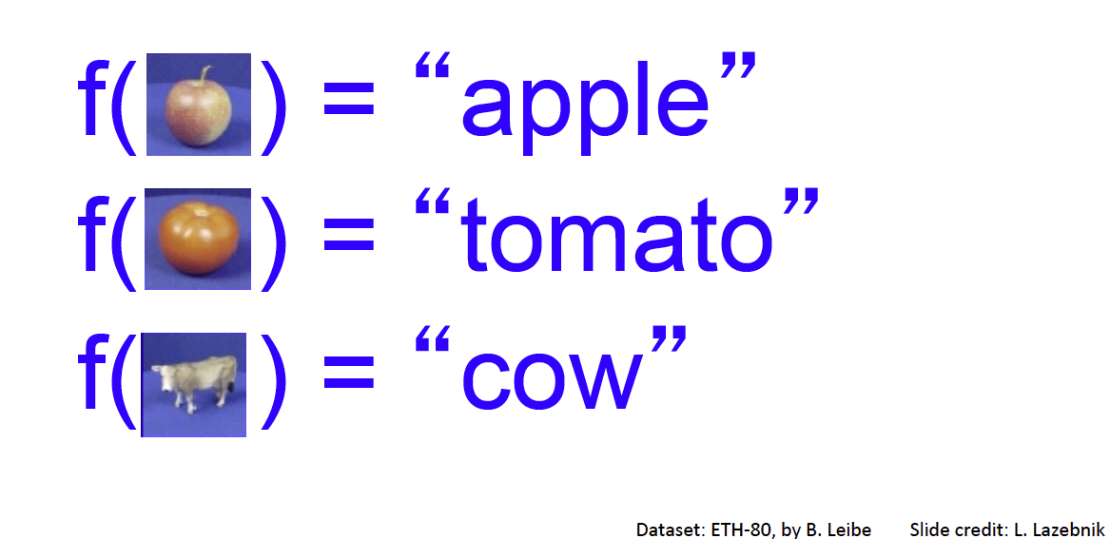
Categorization

Slide 5
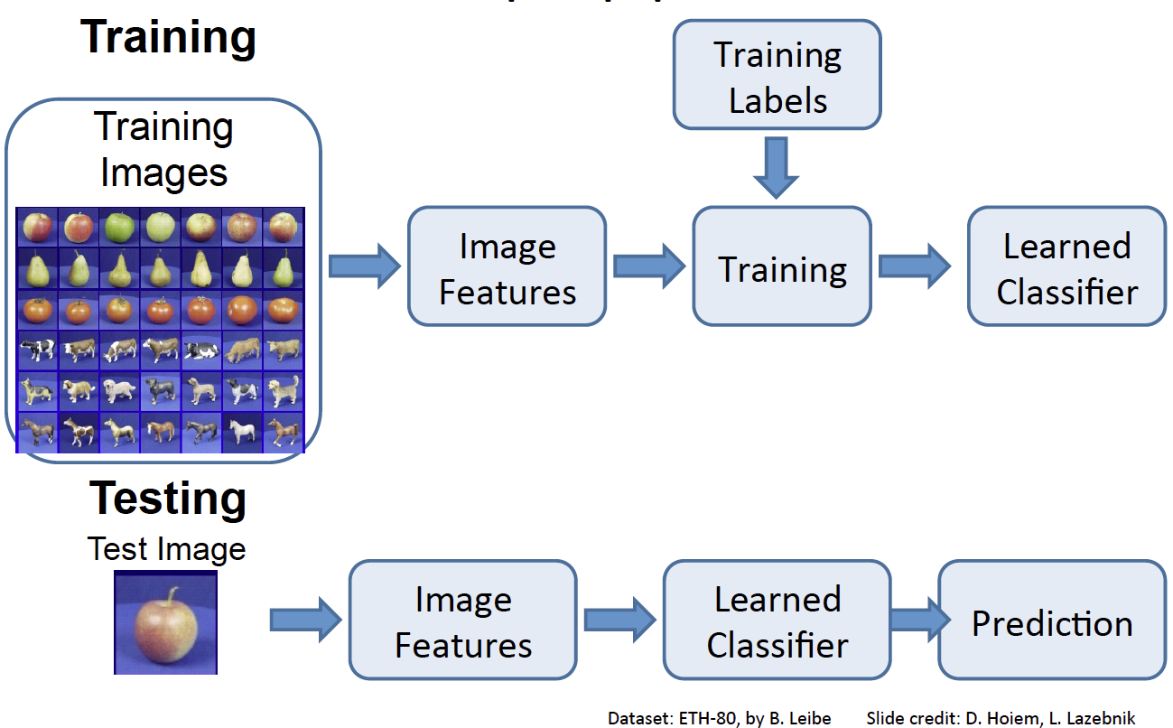

Slide 6
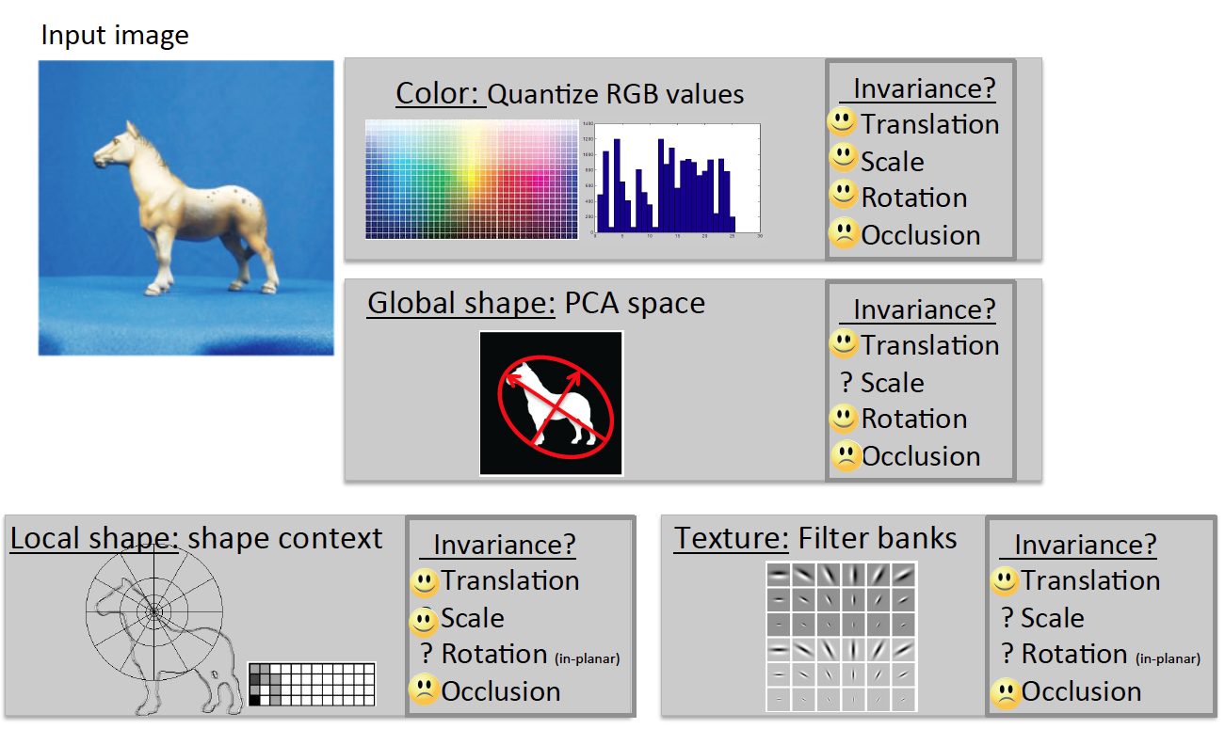

Slide 7
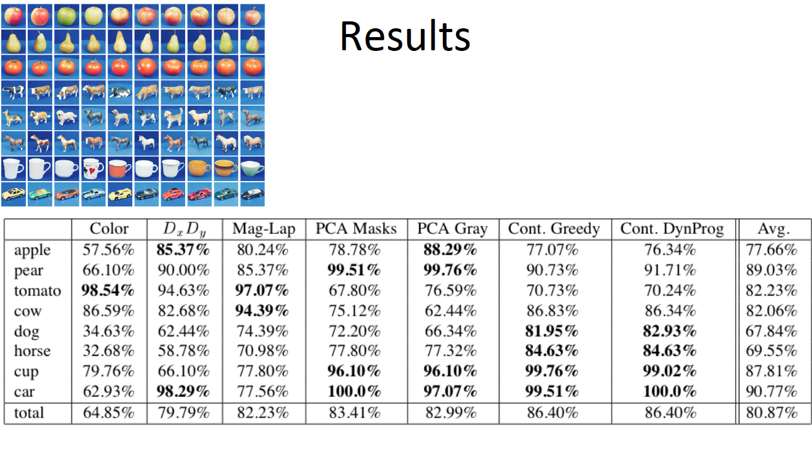

Slide 8
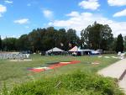
Image Categorization
Training
Training Images
Training Labels
Image Features
Classifier Training
Trained Classifier
Testing
Image Features
Trained Classifier
Prediction
Outdoor
Test Image

Slide 9

Crowdsourcing
Unlabeled Images
Show images,
Collect and filter labels
Training Labels
Training Images
Image Features
Classifier Training
Trained Classifier
Training

Slide 10
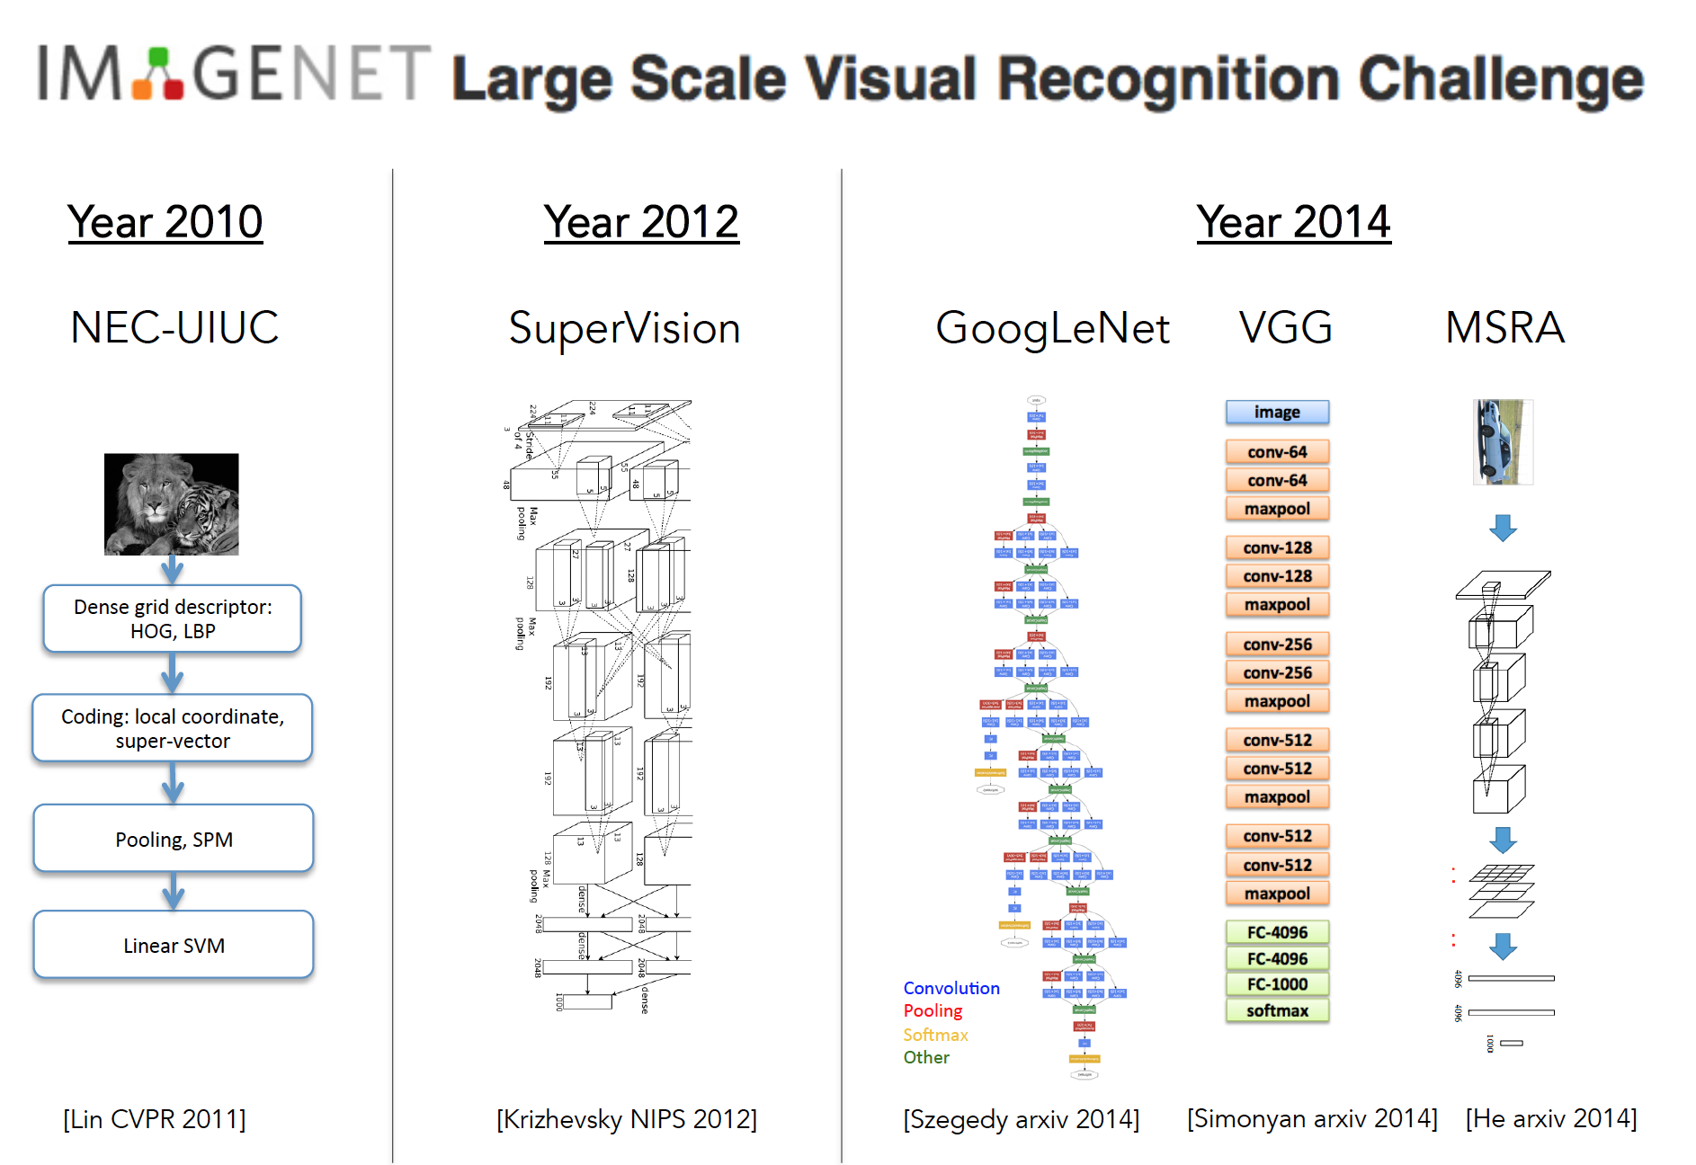

Slide 11
Deep Learning or CNNs
Since 2012, huge impact…, best results
Can soak up all the data for better prediction

Slide 12
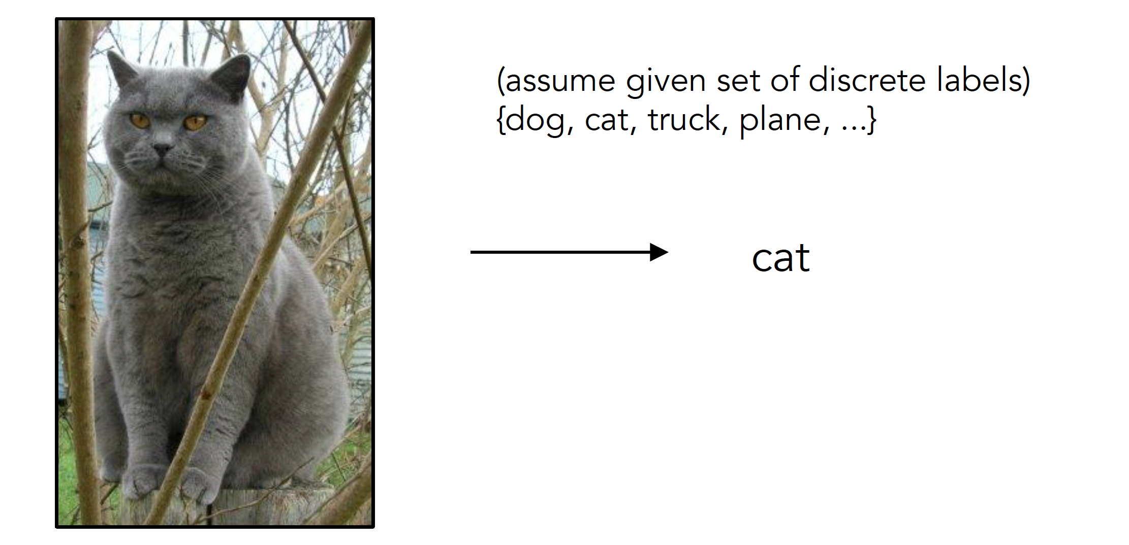
Image Classification
Slides from Andrej Karpathy and Fei-Fei Li
http://vision.stanford.edu/teaching/cs231n/

Slide 13

Image Classification: Problem

Slide 14
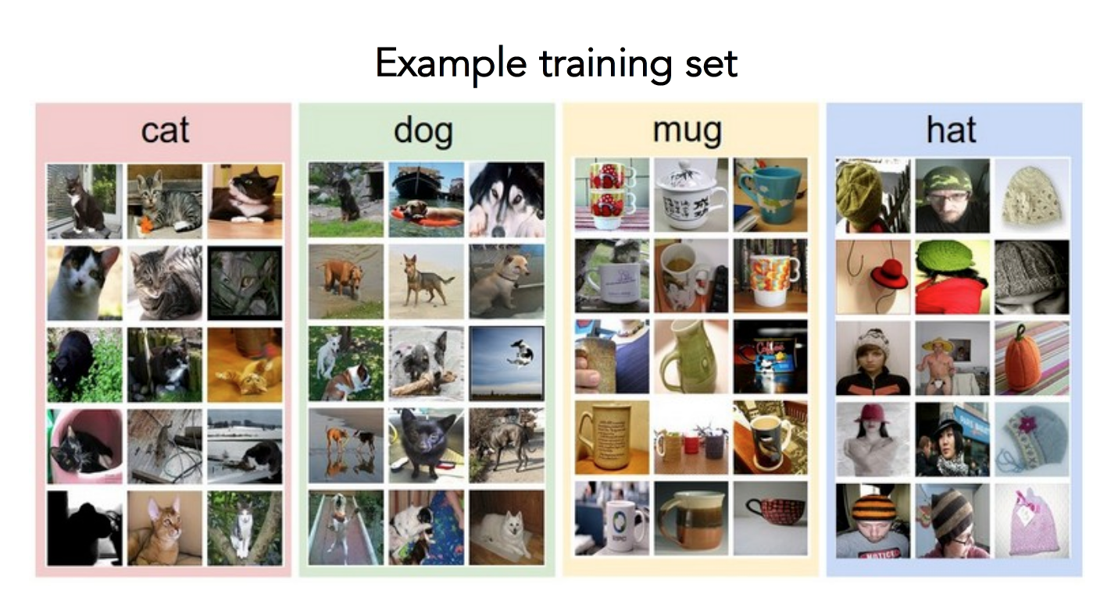
Data-driven approach
Collect a database of images with labels
Use ML to train an image classifier
Evaluate the classifier on test images
Slides from Andrej Karpathy and Fei-Fei Li
http://vision.stanford.edu/teaching/cs231n/

Slide 15
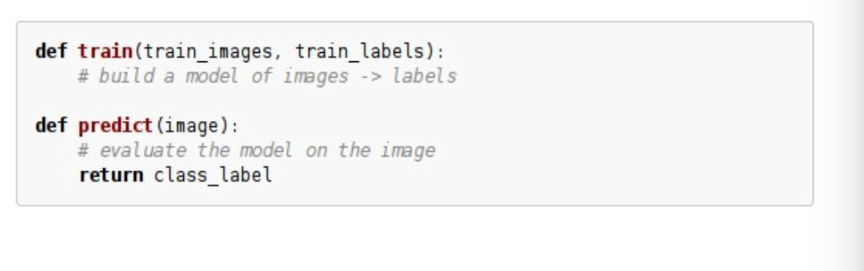
Data-driven approach
Collect a database of images with labels
Use ML to train an image classifier
Evaluate the classifier on test images
Slides from Andrej Karpathy and Fei-Fei Li
http://vision.stanford.edu/teaching/cs231n/

Slide 16
Train and Test
Split dataset between training images and test images
Be careful about inflation of results

Slide 17
Classifiers
Nearest Neighbor
kNN
SVM
…

Slide 18
First: Nearest Neighbor (NN) Classifier
Train
Remember all training images and their labels
Predict
Find the closest (most similar) training image
Predict its label as the true label

Slide 19
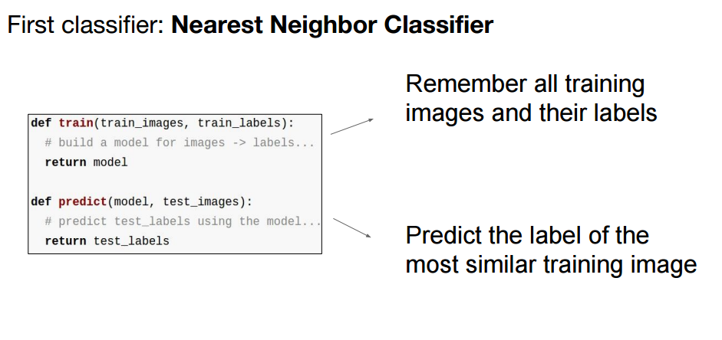

Slide 20
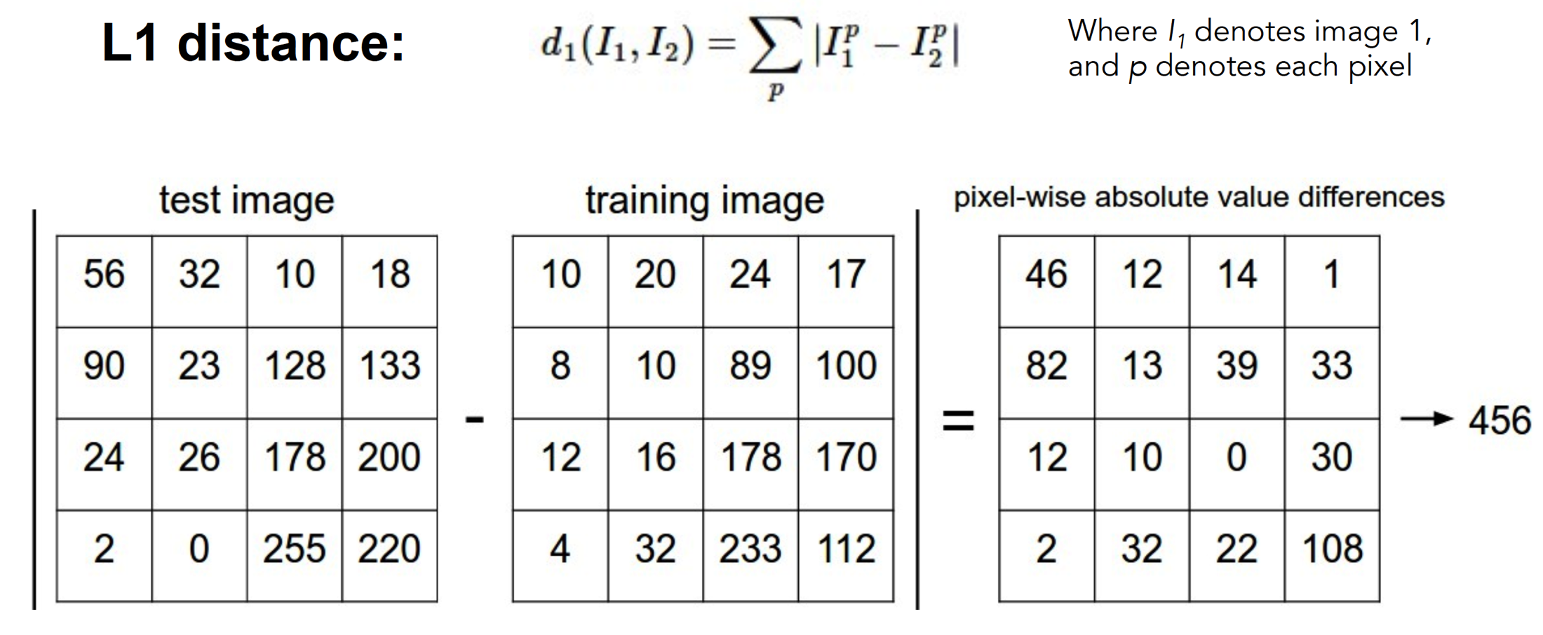
How to find the most similar training image? What is the distance metric?
Slides from Andrej Karpathy and Fei-Fei Li
http://vision.stanford.edu/teaching/cs231n/

Slide 21
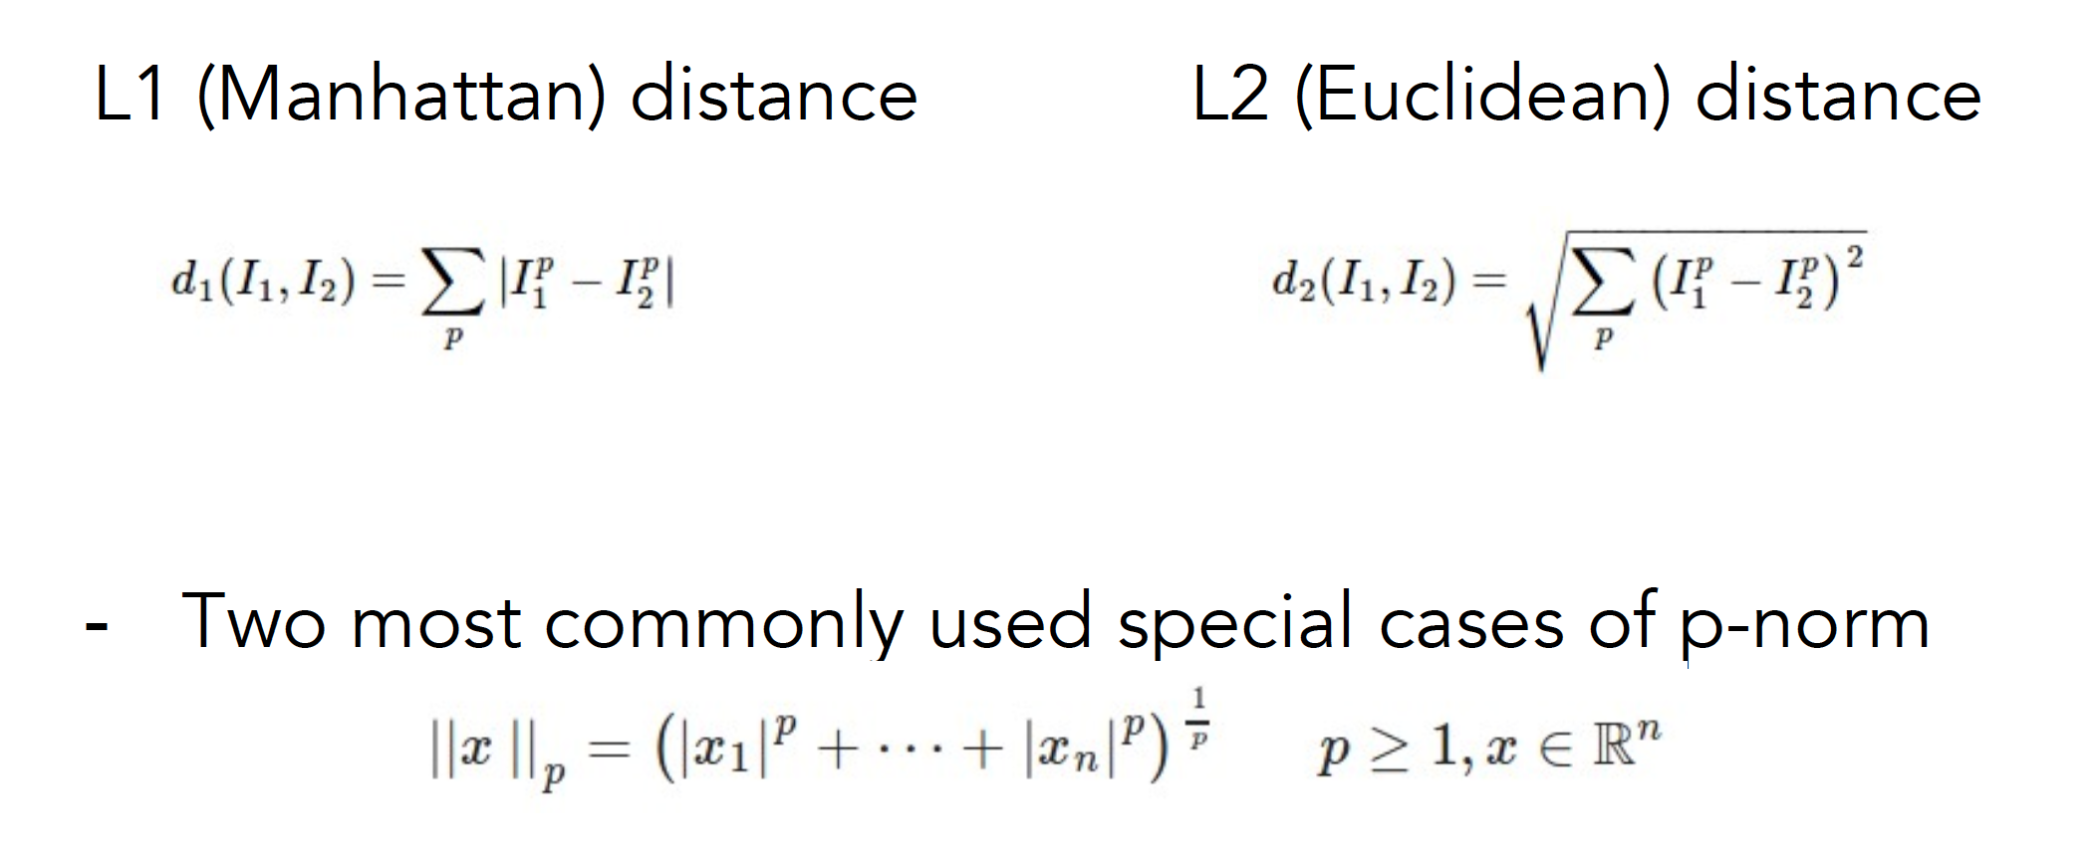
Choice of distance metric
Hyperparameter
Slides from Andrej Karpathy and Fei-Fei Li
http://vision.stanford.edu/teaching/cs231n/

Slide 22
Visualization: L2 distance
Notes:
Background plays an unrealistically large role

Slide 23
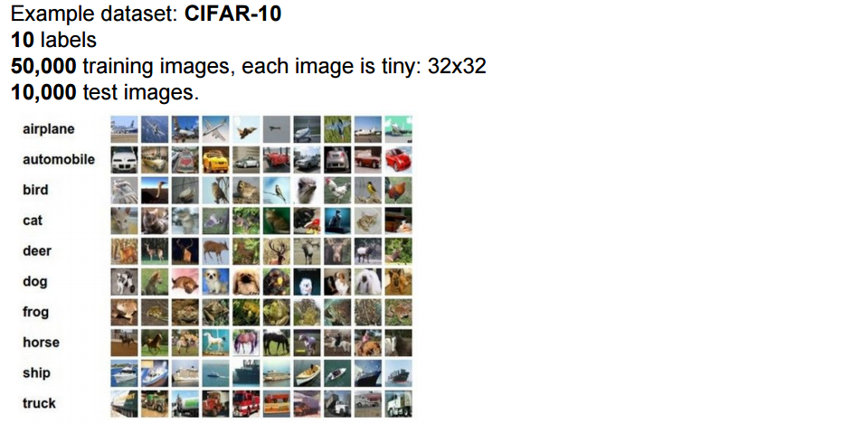
CIFAR-10 and NN results

Slide 24
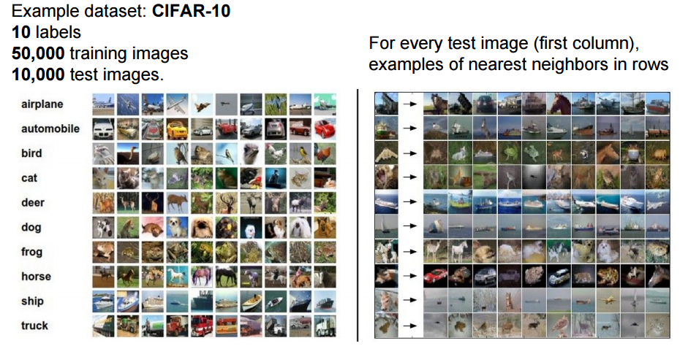
CIFAR-10 and NN results
Slides from Andrej Karpathy and Fei-Fei Li
http://vision.stanford.edu/teaching/cs231n/

Slide 25
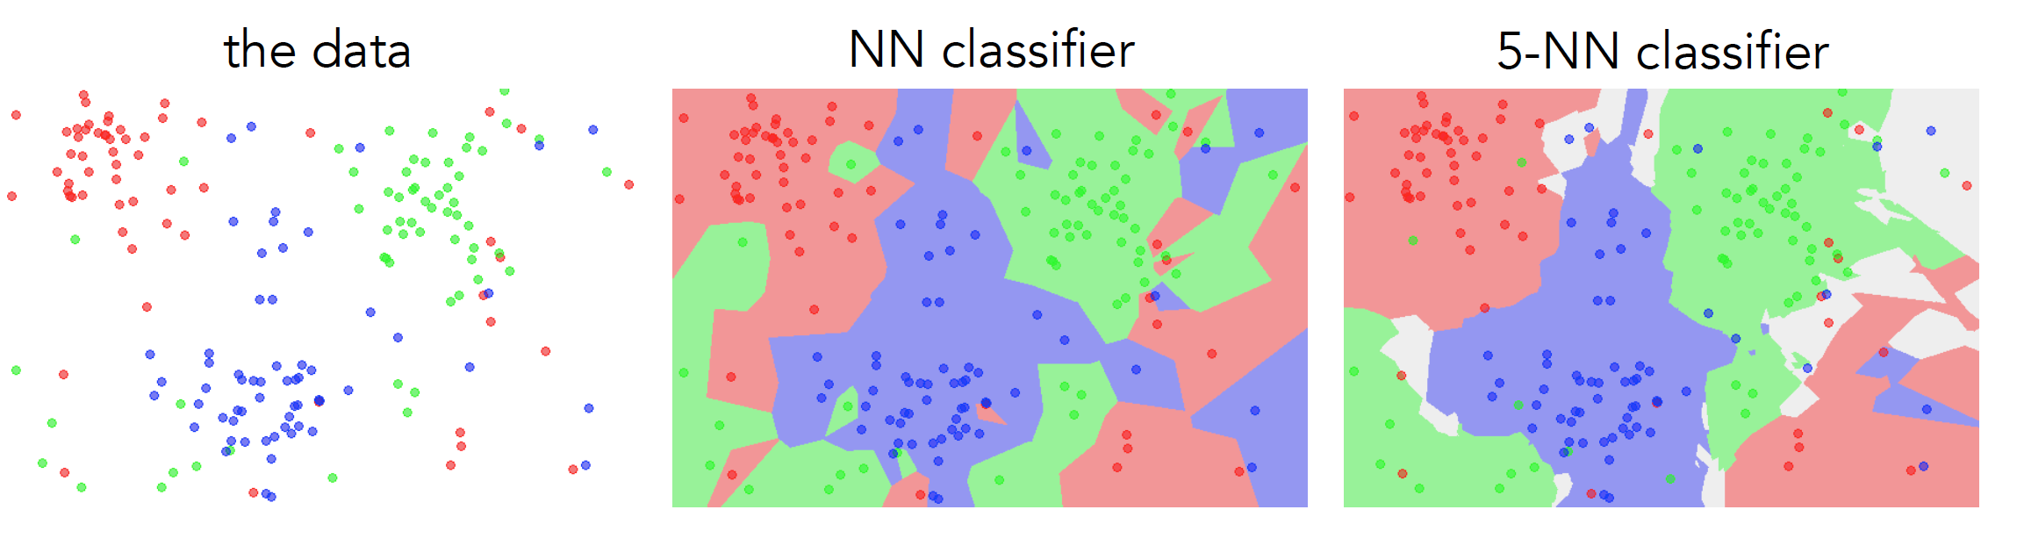
k-nearest neighbor
Find the k closest points from training data
Labels of the k points “vote” to classify

Slide 26
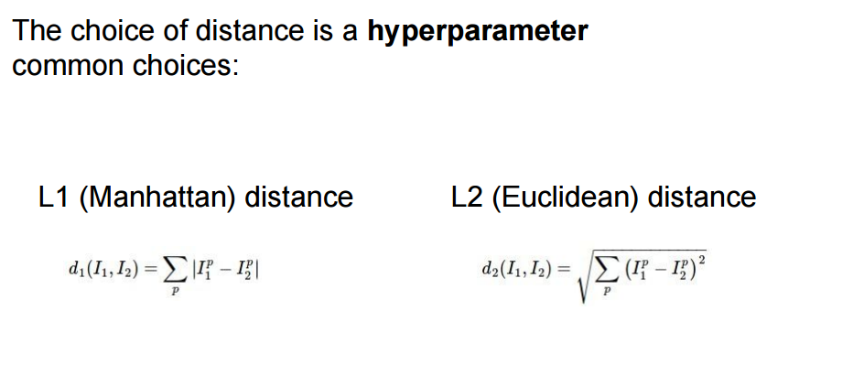
Hyperparameters

Slide 27
Hyperparameters
What is the best distance to use?
What is the best value of k to use?
i.e., how do we set the hyperparameters?
Very problem-dependent
Must try them all and see what works best

Slide 28
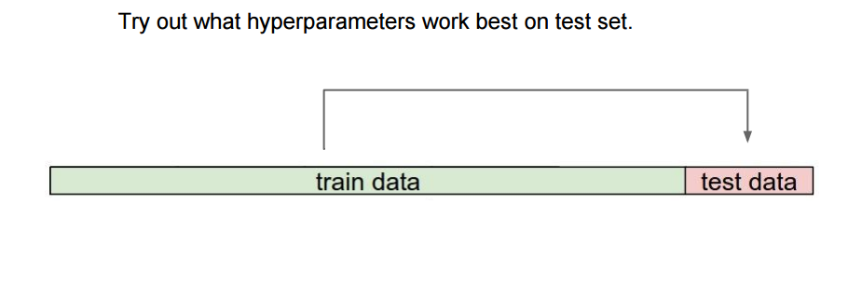

Slide 29
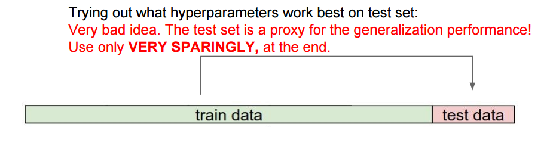

Slide 30
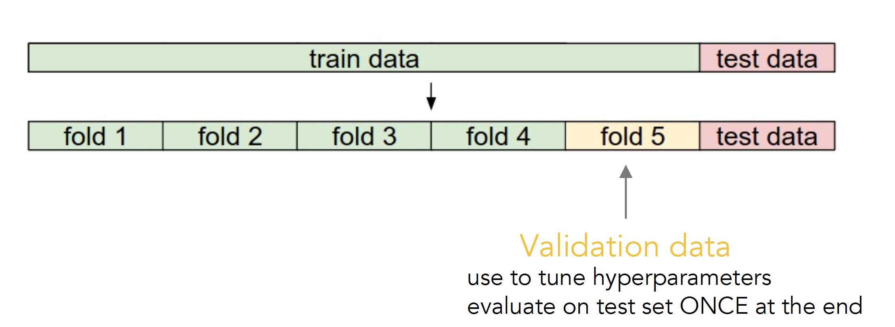
Validation
Slides from Andrej Karpathy and Fei-Fei Li
http://vision.stanford.edu/teaching/cs231n/

Slide 31
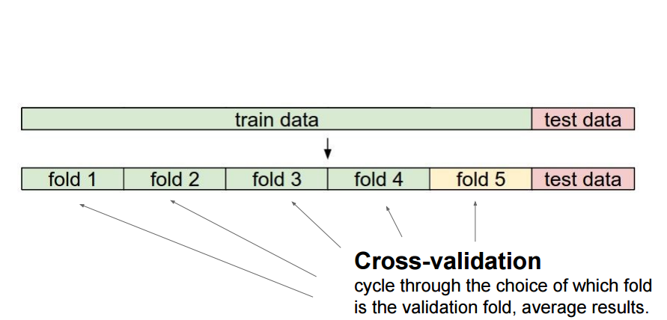
Cross-validation
Slides from Andrej Karpathy and Fei-Fei Li
http://vision.stanford.edu/teaching/cs231n/

Slide 32
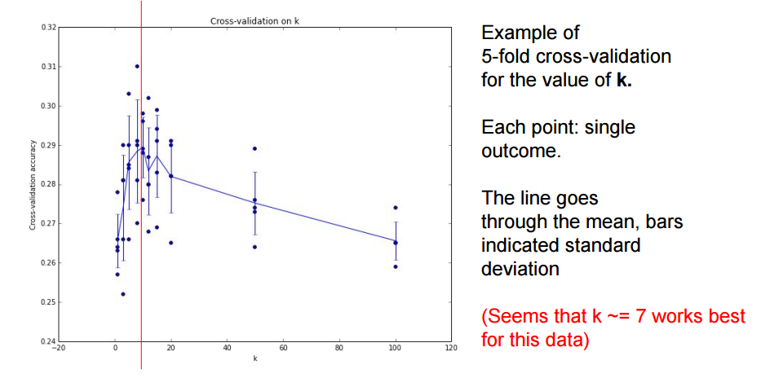

Slide 33
How to pick hyperparameters?
Methodology
Train and test
Train, validate, test
Train for original model
Validate to find hyperparameters
Test to understand generalizability

Slide 34
kNN -- Complexity and Storage
N training images, M test images
Training: O(1)
Testing: O(MN)
Hmm…
Normally need the opposite
Slow training (ok), fast testing (necessary)

Slide 35
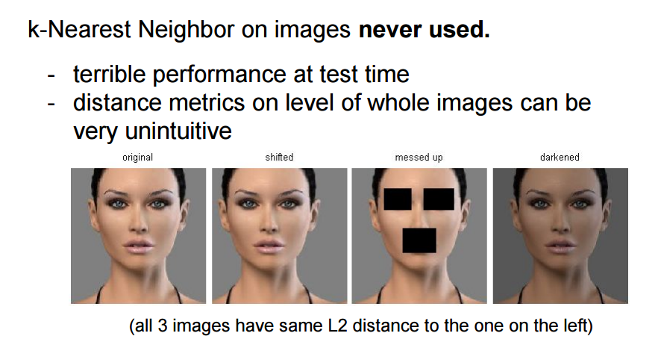

Slide 36
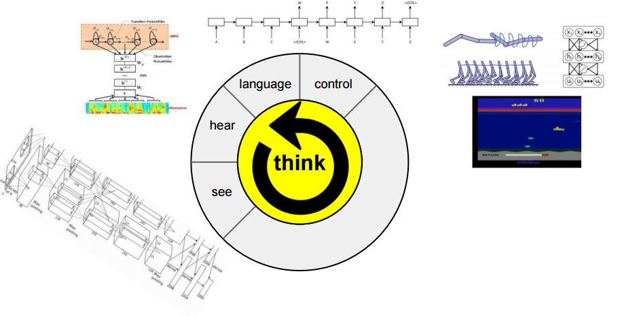
Instead
Image classification using linear classifiers

Slide 37
Instead
Image classification using linear classifiers
Need
Score function: raw data to class scores
Loss function: agreement between predicted scores and ground truth labels

Slide 38
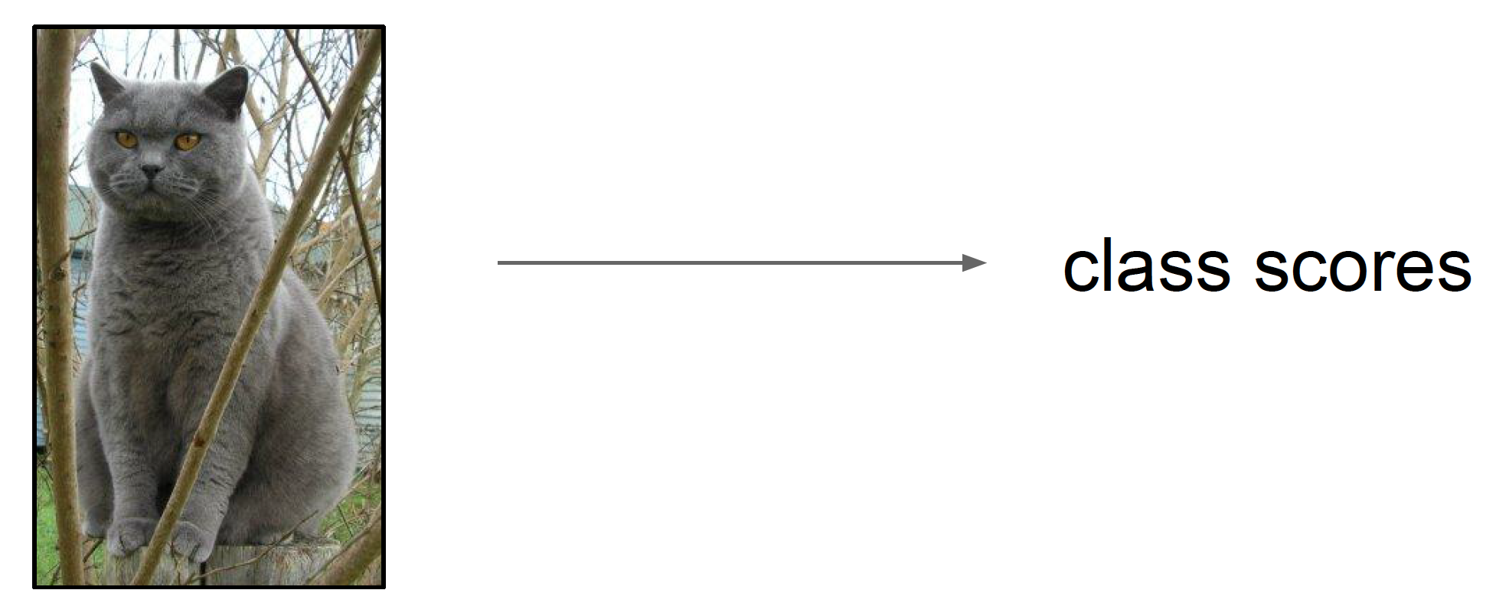
Score function
Slides from Andrej Karpathy and Fei-Fei Li
http://vision.stanford.edu/teaching/cs231n/

Slide 39
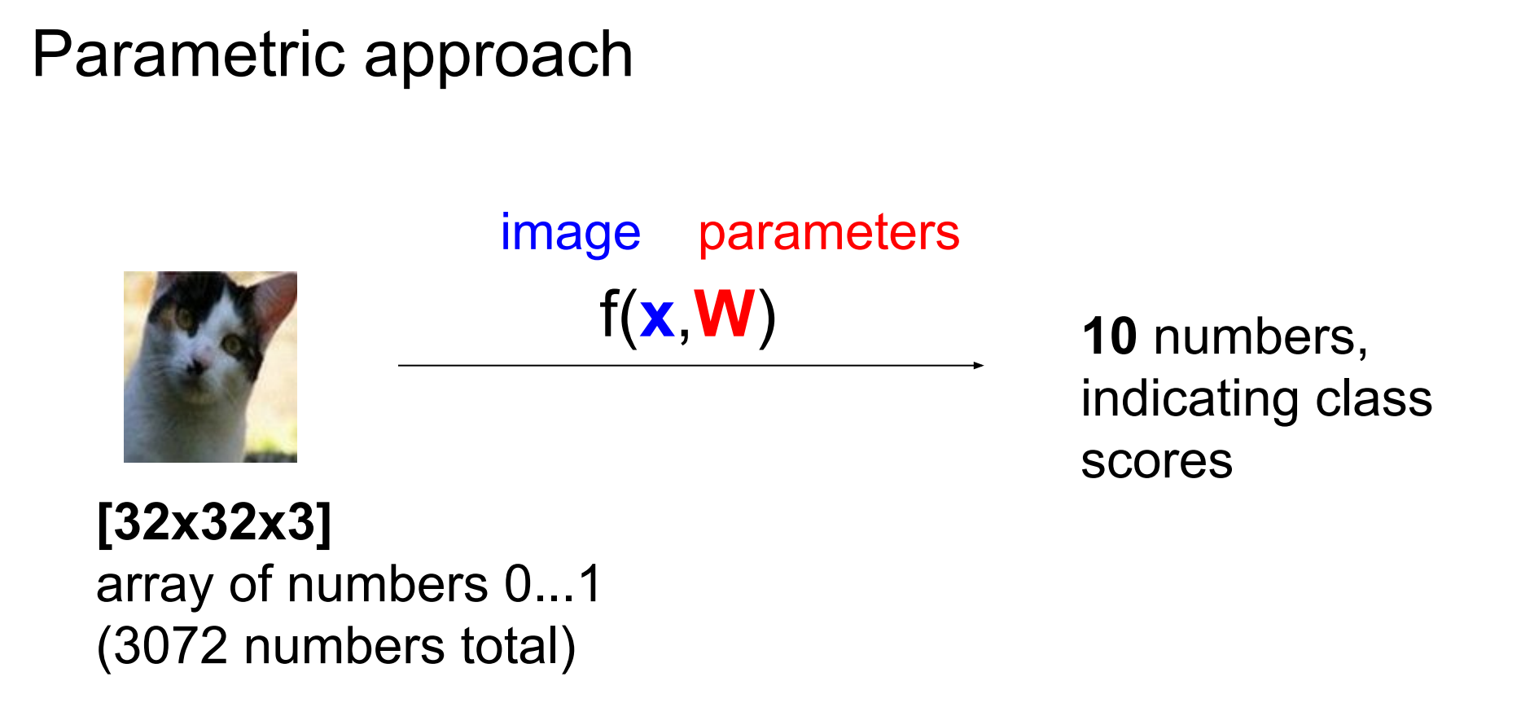
Score function: f

Slide 40
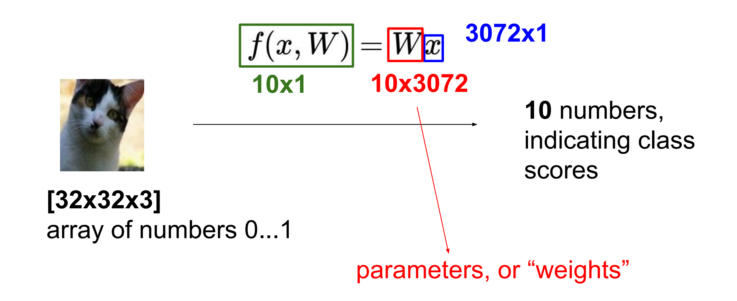
Parametric approach: Linear classifier

Slide 41
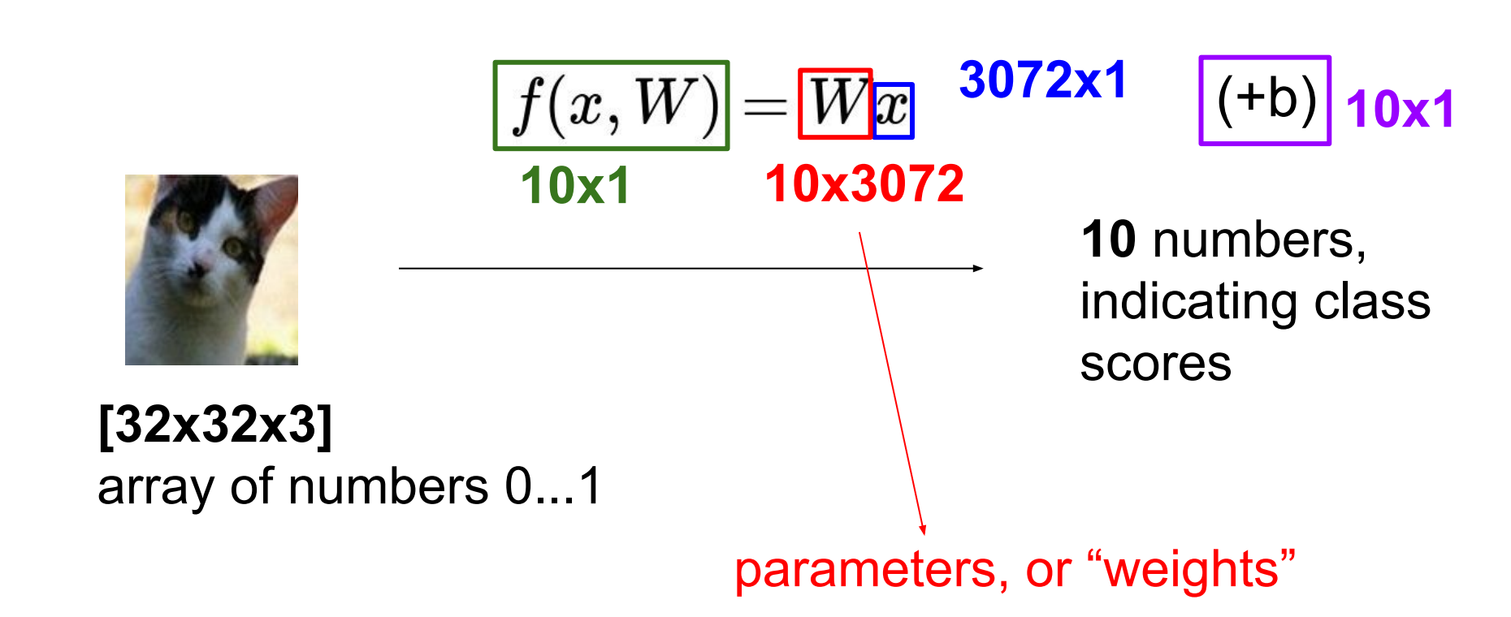
Parametric approach: Linear classifier

Slide 42
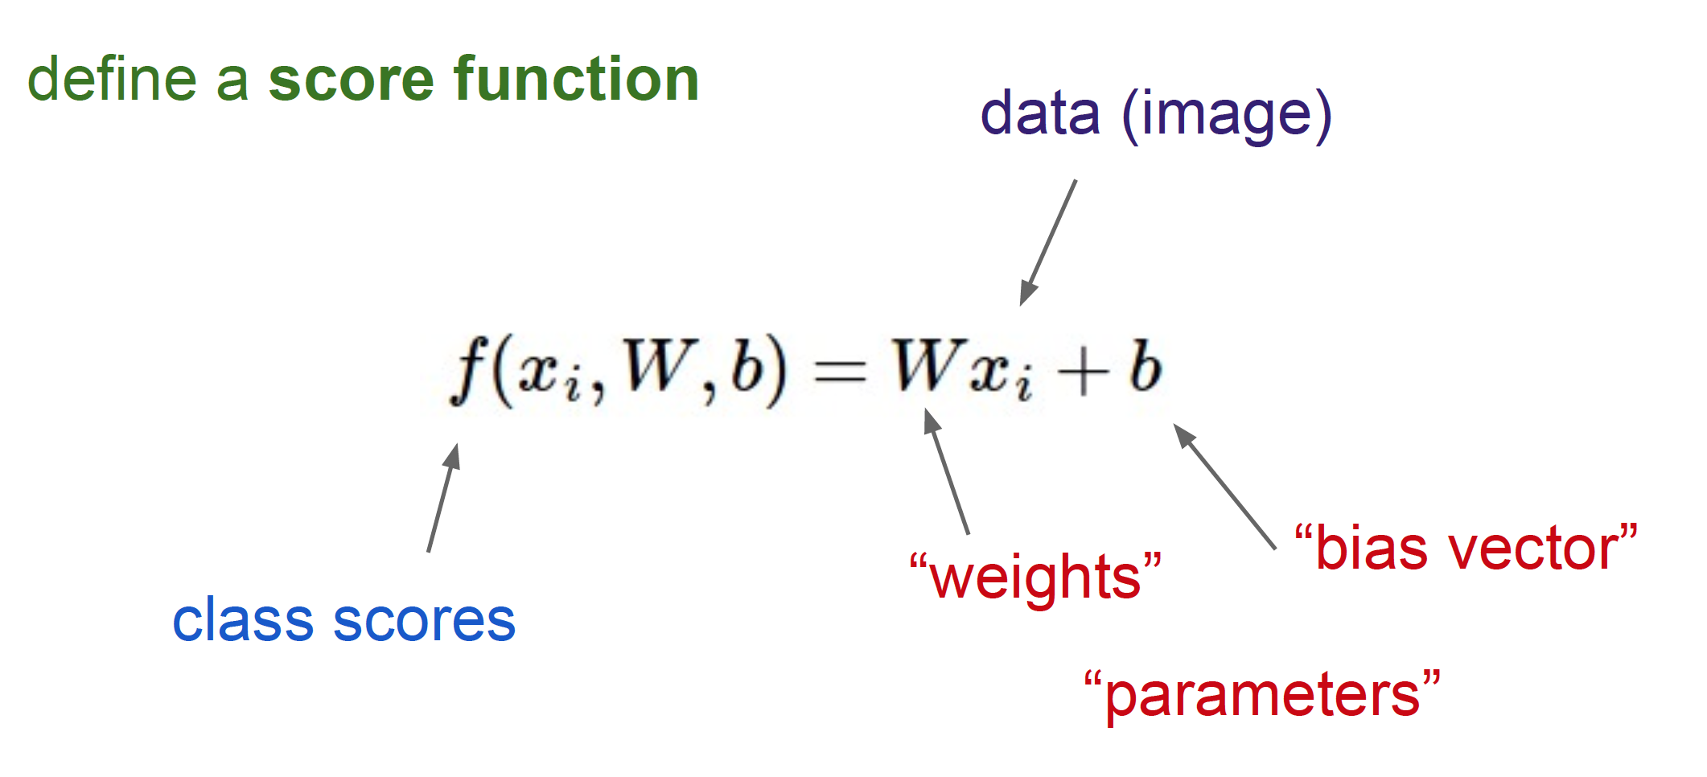
Linear Classifier

Slide 43
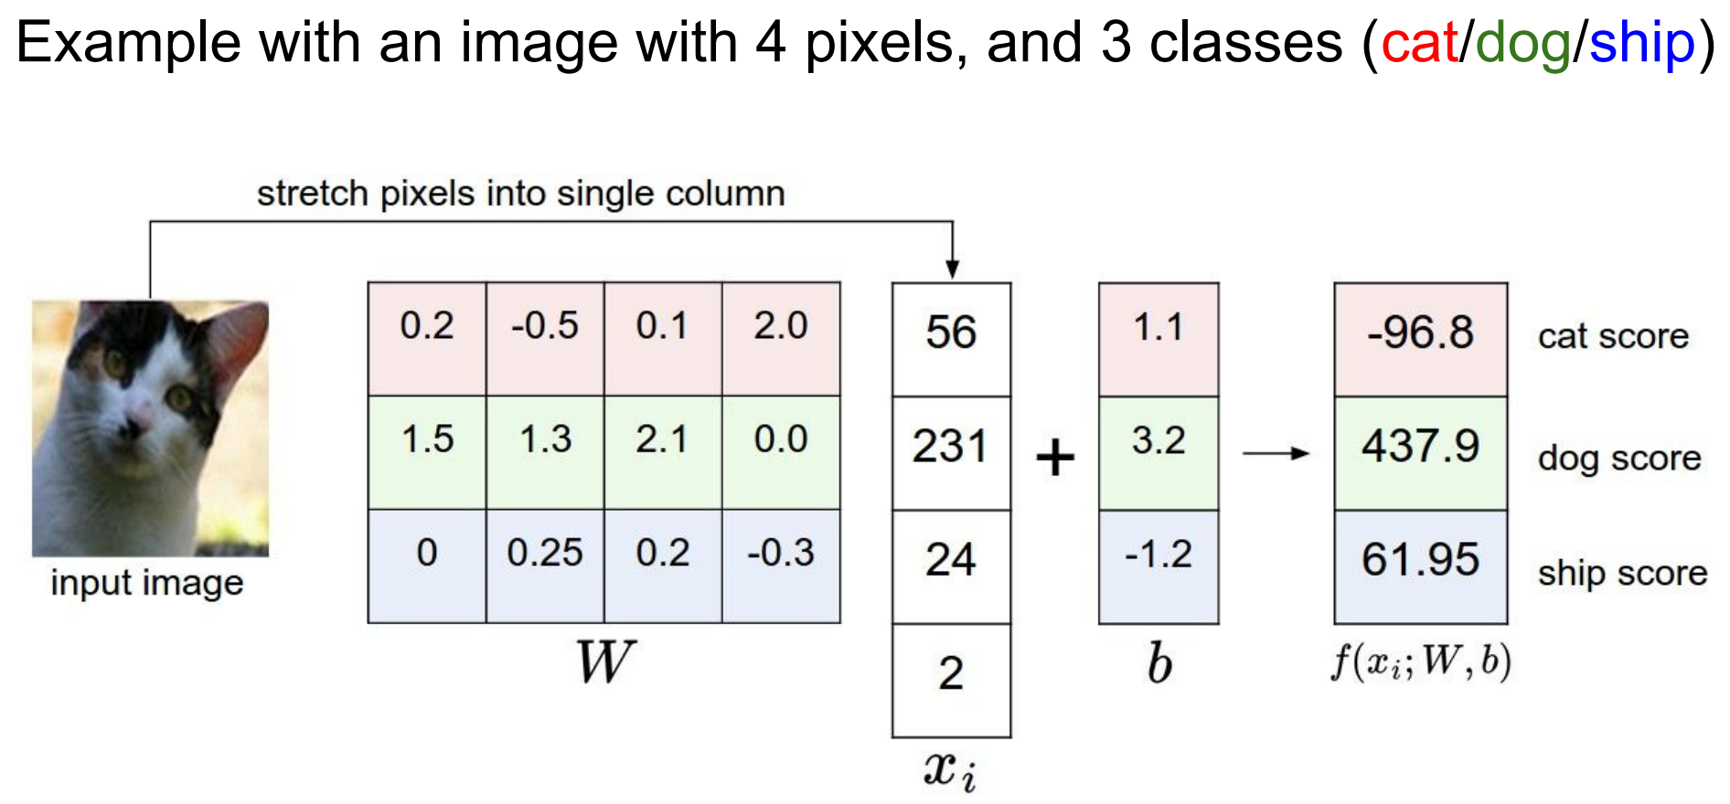

Slide 44
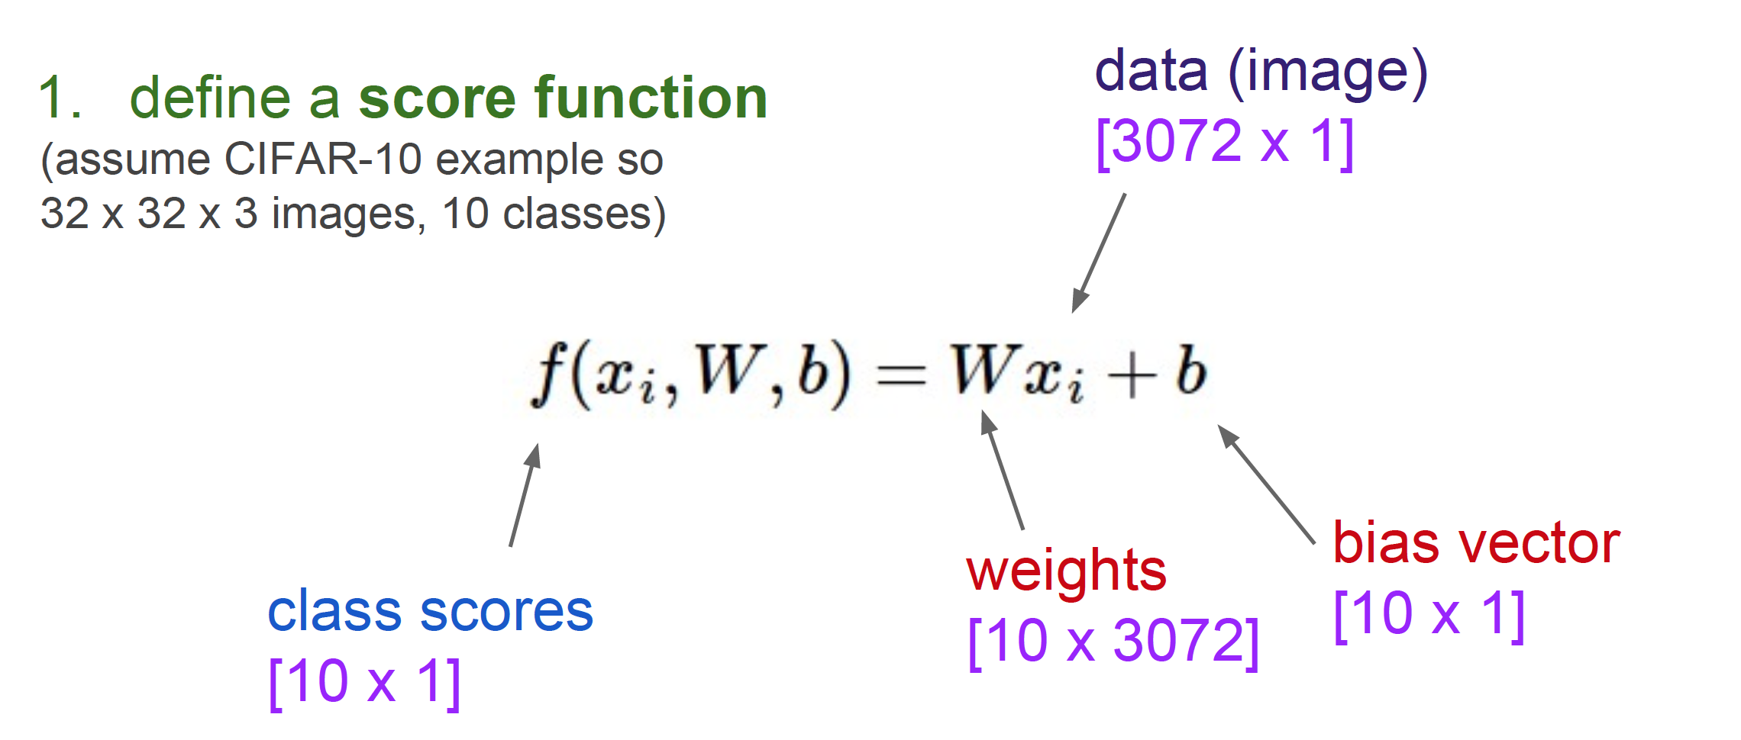
Linear Classifier

Slide 45
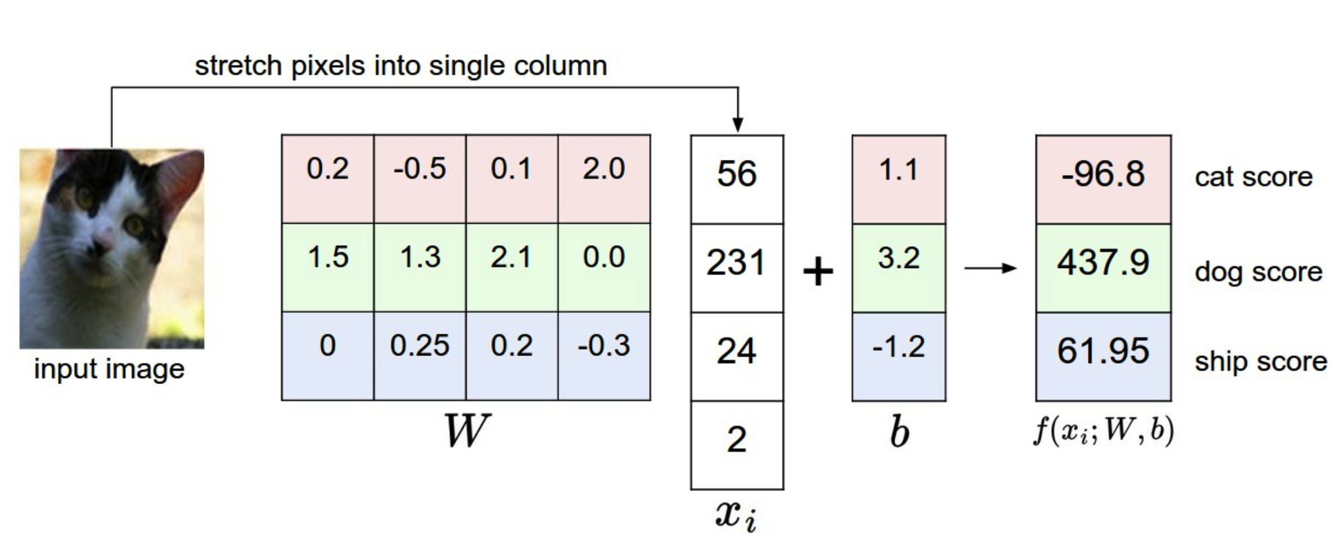
Computing scores
Notes:
This is a bad cat score

Slide 46
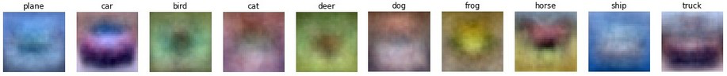
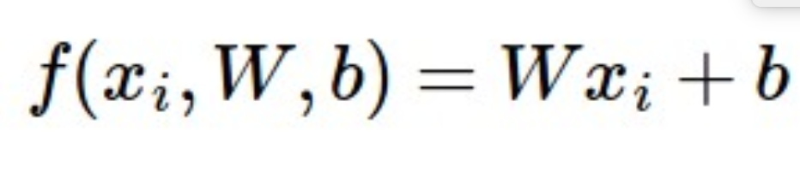
Interpretation: Template matching
Notes:
Each row of W is a template for that class

Slide 47
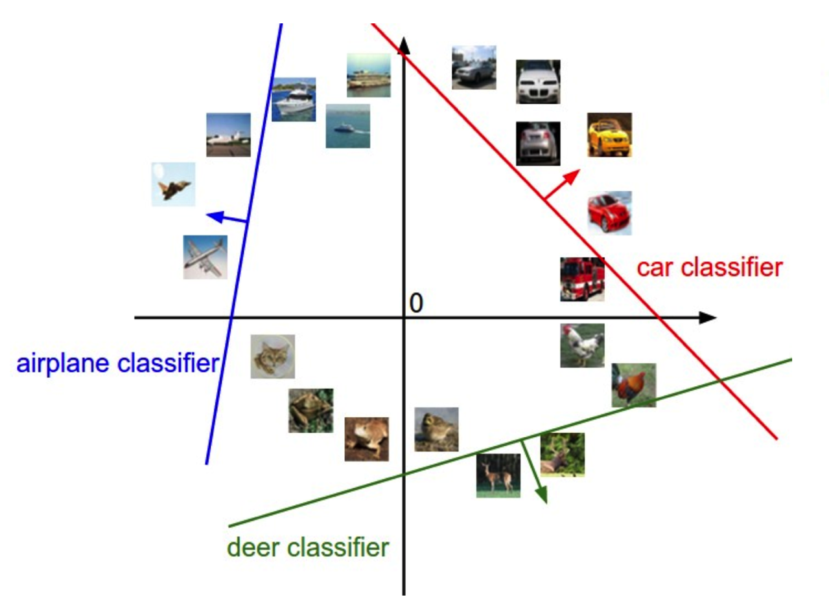
Geometric Interpretation

Slide 48
Linear classifiers
Find linear function (hyperplane) to separate positive and negative examples
Which hyperplane is best?

Slide 49
Support vector machines
Find hyperplane that maximizes the margin between the positive and negative examples
C. Burges, A Tutorial on Support Vector Machines for Pattern Recognition, Data Mining and Knowledge Discovery, 1998

Slide 50
Support vector machines
Find hyperplane that maximizes the margin between the positive and negative examples
For support, vectors,
Support vectors
Margin

Slide 51
Support vector machines
Find hyperplane that maximizes the margin between the positive and negative examples
For support, vectors,
Distance between point and hyperplane:
Therefore, the margin is 2 / ||w||
Support vectors
Margin
Notes:
This is a generalization of binary SVMs to multiple classes

Slide 52
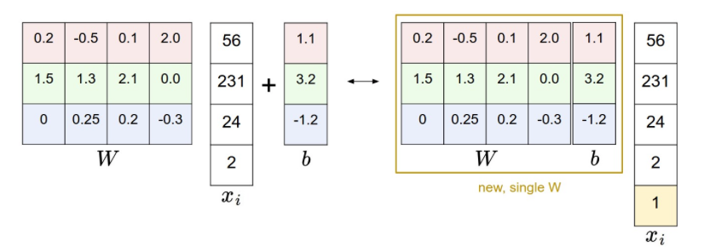
Bias Trick

Slide 53
Summary
Data-driven: Train, validate, test
Need labeled data
Classifier
Nearest neighbor, kNN

Slide 54
Loss function, cost/objective function
Given ground truth labels (yi), scores f (xi, W)
how unhappy are you with the scores?
Loss function or objective/cost function
Want to minimize the loss function

Slide 55
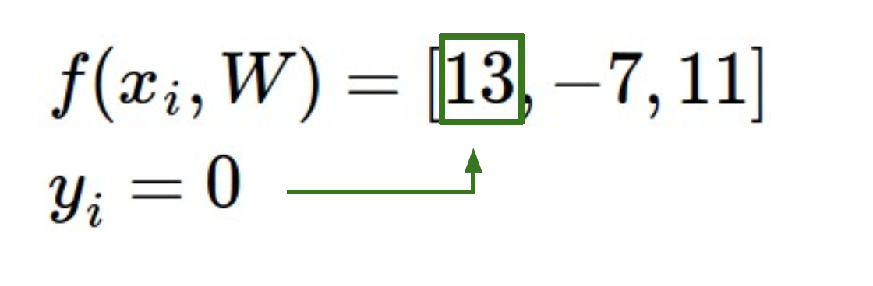
Loss function, cost/objective function
Given ground truth labels (yi) and scores f(xi, W)
how unhappy are you with the scores?

Slide 56
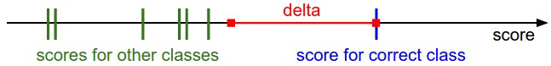
Intuition

Slide 57
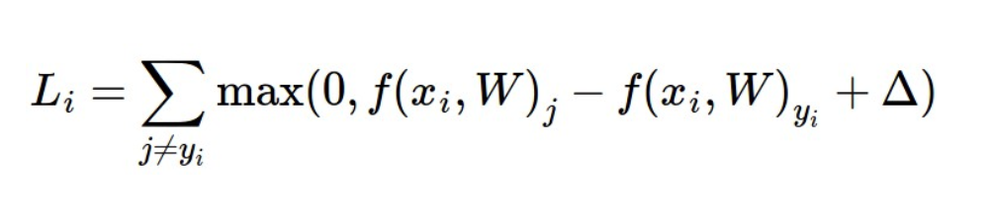
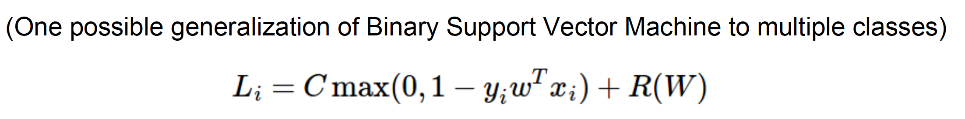
Loss fn: Multi-class SVM loss
Given ground truth labels (yi) and scores f(xi, W)
how unhappy are you with the scores?
Notes:
Yi = 0 f (xi, W) = [13, -7, 11]. Let Delta be 10.

Slide 58
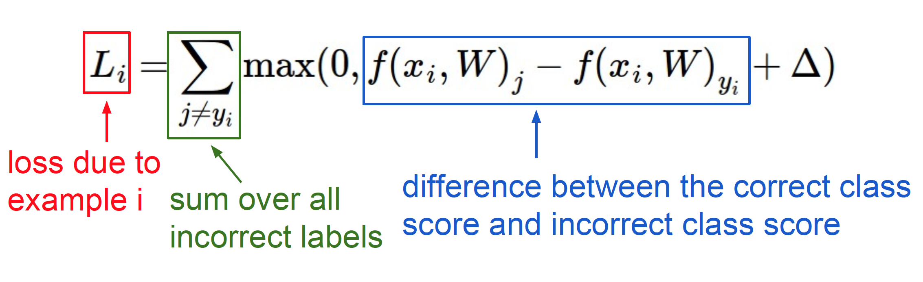
Loss fn: interpretation

Slide 59
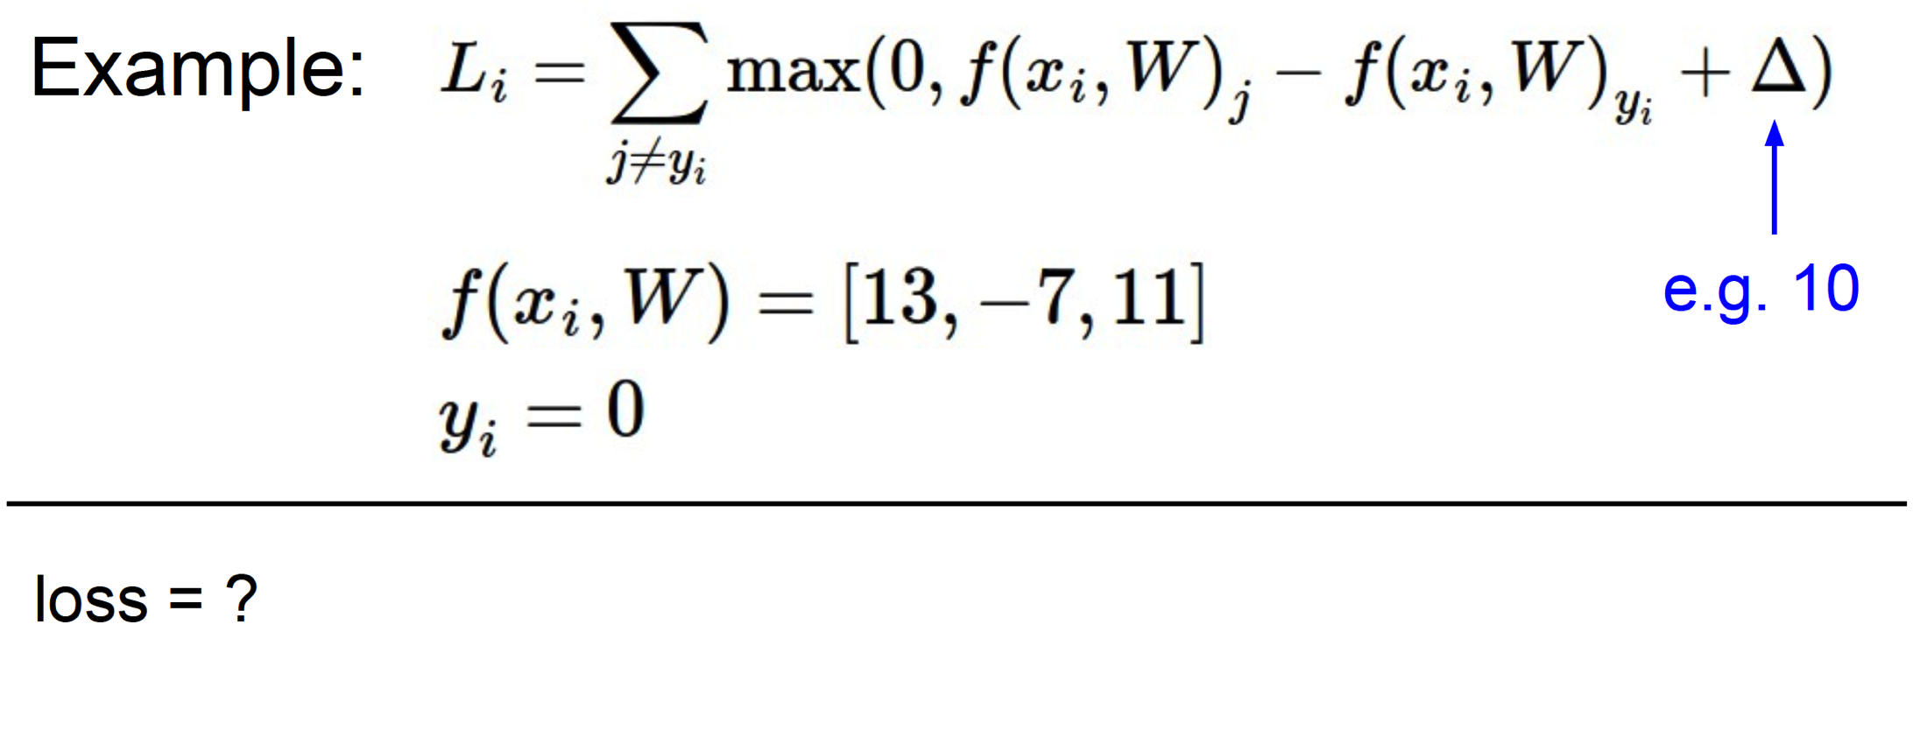
Example: loss

Slide 60
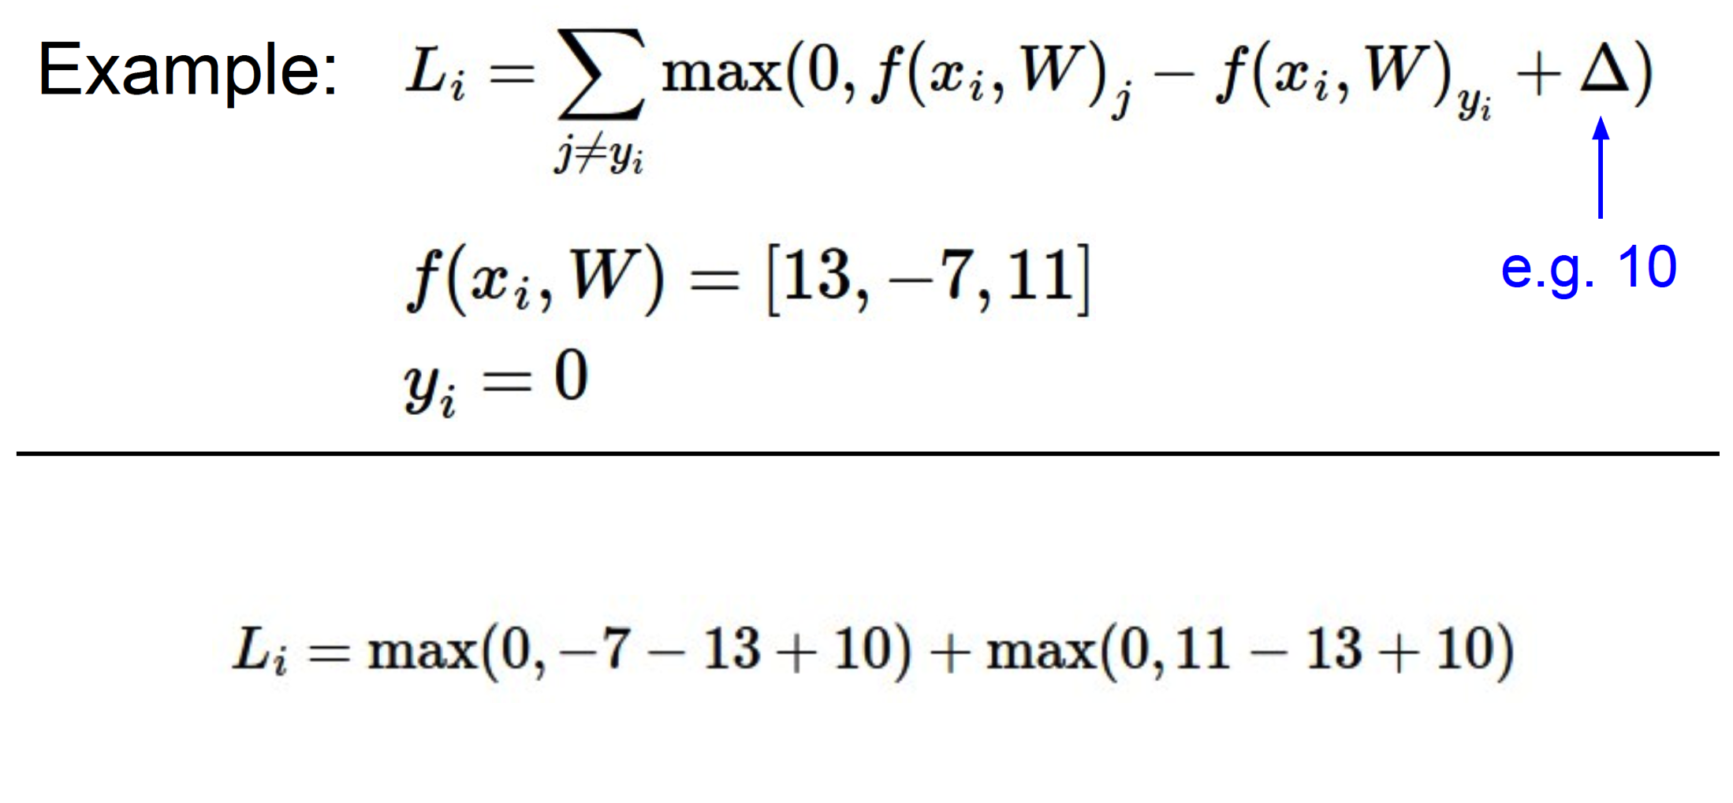
Example: loss

Slide 61
Need more..
Regularization
Ambiguity: W is not unique
If loss is 0, k W also has 0 loss
Add a regularization penalty
Try to keep the weights low
Also, weights can blow up if you don’t have it

Slide 62
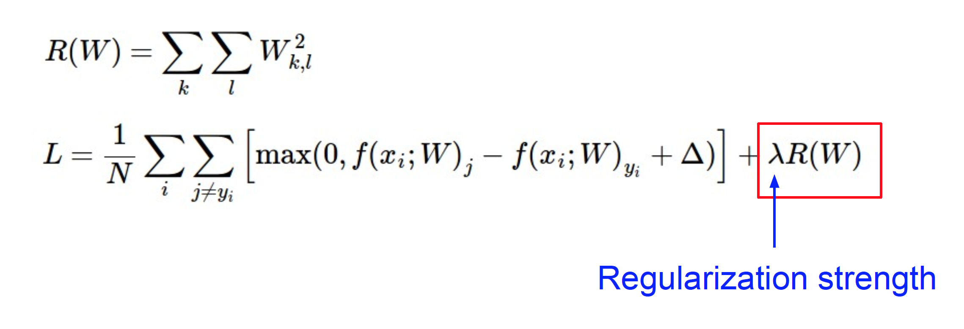
Important: regularization
Determine by cross-validation
Notes:
In addition to the motivation we provided above there are many desirable properties to include the regularization penalty. For example, it turns out that including the L2 penalty leads to the appealing max margin property in SVMs (See CS229 lecture notes for full details if you are interested

Slide 63
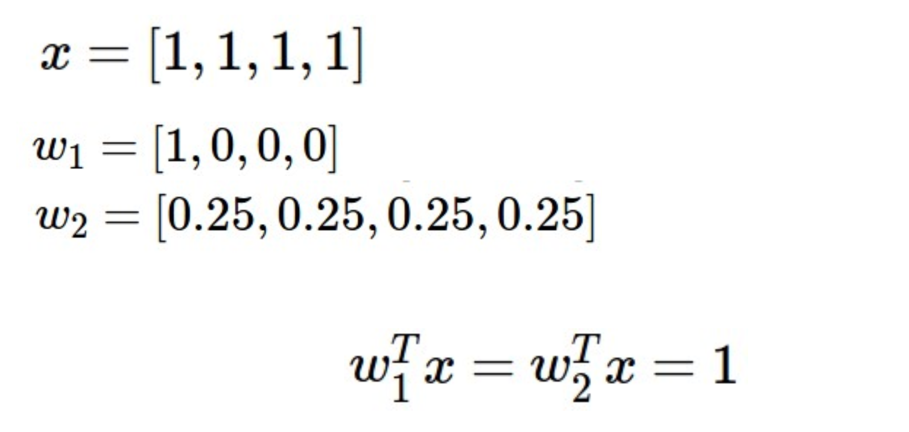
Example: regularization
Notes:
The most appealing property is that penalizing large weights tends to improve generalization, because it means that no input dimension can have a very large influence on the scores all by itself.
Regularization penalty is 1 vs. ¼. Downweights any one feature and makes it more diffuse.

Slide 64
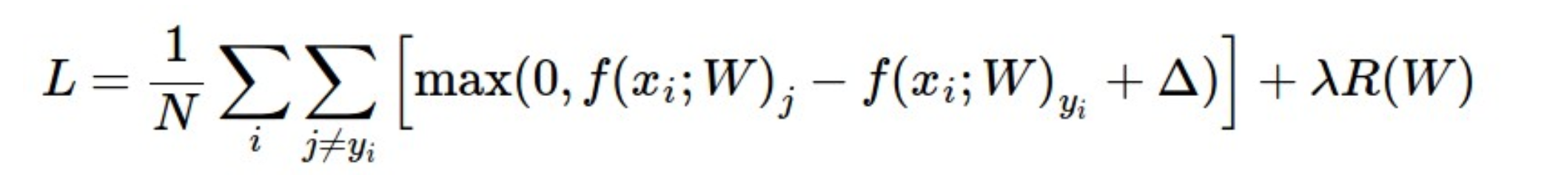
Final loss function
Can set delta to 1
Notes:
In addition to the motivation we provided above there are many desirable properties to include the regularization penalty, many of which we will come back to in later sections. For example, it turns out that including the L2 penalty leads to the appealing max margin property in SVMs (See CS229 lecture notes for full details if you are interested).

Slide 65
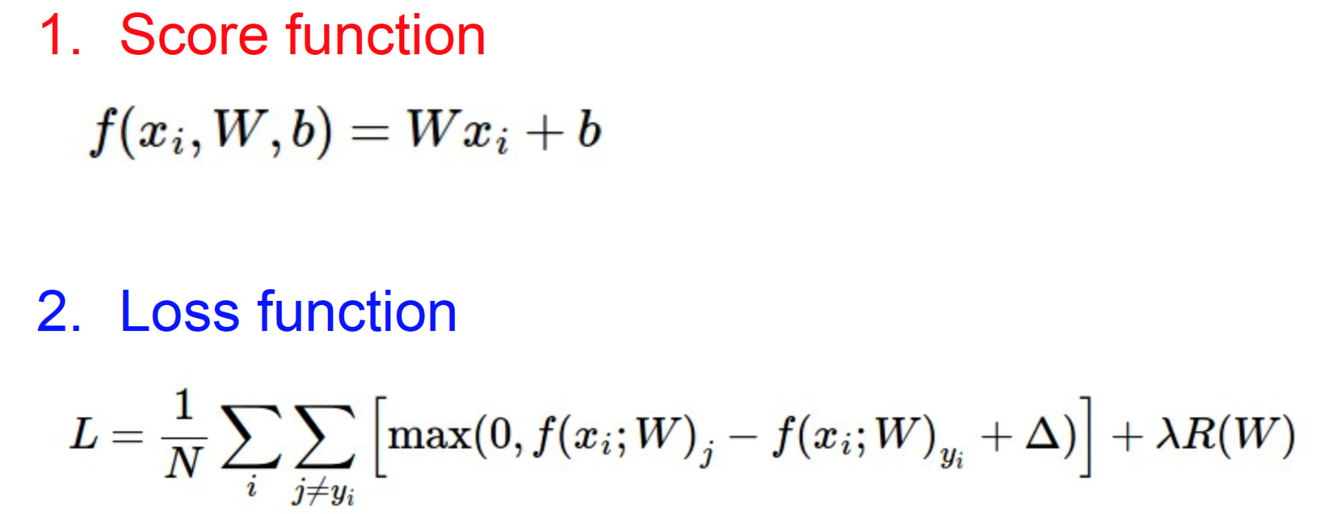
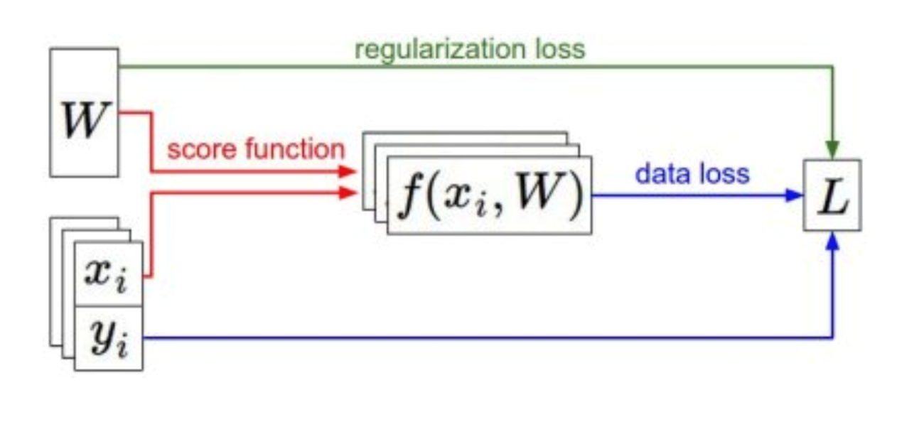
Summary

Slide 66
http://vision.stanford.edu/teaching/cs231n/linear-classify-demo/

Slide 67
Summary
Have score function and loss function
Will generalize the score function
Find W and b to minimize loss
Minimize loss using gradient descent
Now to CNNs

